Slide 1
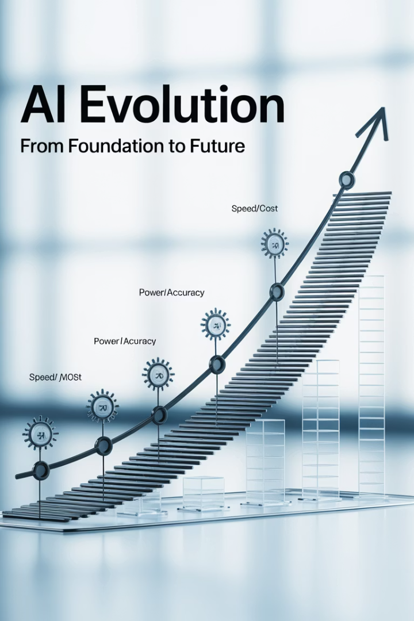
LLM Strategy & Evolution
Our approach to leveraging Large Language Models for RPG modernization follows a strategic evolution path, starting with practical proof-of-concept models and scaling to more powerful specialized solutions.
AS
by Advik Sarang

Slide 2

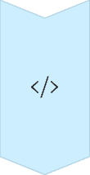


Our LLM Approach: Starting Smart, Scaling Power
Initial Proof of Concept (POC) Model
We utilized [Current POC Model Name, e.g., Gemini 1.5 Flash / GPT-3.5-Turbo] for the initial development and validation of the RPG Modernization Tool.
Why? This model offered a strong balance of capability, speed, and cost-effectiveness, allowing us to rapidly prove the core concepts of the automated analysis and generation pipeline.
Future Enhancement: Leveraging Advanced SWE Models
The true potential of this tool will be unlocked by integrating more powerful Large Language Models specifically designed or fine-tuned for Software Engineering tasks (often referred to as "SWE models").
Examples include models like GPT-4o, Claude 3 Opus, Gemini 1.5 Pro, or future specialized code-generation models.
Expected Benefits of Advanced Models
Higher Accuracy: Improved understanding of complex RPG logic and nuances (including Synon patterns).
Superior Code Generation: More idiomatic, efficient, and complete target code drafts (Python/Java).
Deeper Semantic Understanding: Better inference of business rules and intent from the code.
Enhanced Documentation: More insightful and context-aware business documentation generation.
Conclusion
Our RPG Modernization Tool is built on a flexible architecture. By starting with a practical POC model and planning for upgrades to cutting-edge SWE models, we ensure the tool becomes increasingly powerful and effective, delivering even greater value to our software development lifecycle.

Slide 3

Laying the Groundwork: Why Not Start Directly in Cursor AI?
Challenge
Starting modernization directly in an AI coding assistant like Cursor AI with just raw RPG code means the developer must manually perform or prompt for every analysis step:
Parsing the structure.
Understanding the logic flow.
Generating pseudocode.
Visualizing the flow.
Drafting business logic descriptions.
Creating the initial target code structure.
Requires Heavy Prompting: You'd need extremely detailed context in every prompt to guide the AI effectively.
(This becomes a repetitive, manual reverse-engineering and prompting process within the IDE for each program).

Slide 4










Why the RPG Modernization Tool First?
Massive Efficiency Gain
Gives developers a significant head-start
Refines Context Before Coding
Provides the foundational stone
Provides Essential Context
"Context is King"
Automates Tedious Analysis
Performs foundational steps once
Consistency
Standardized, comprehensive analysis
Our RPG Modernization Tool automates tedious analysis, performing these foundational steps once, automatically, generating a rich set of interconnected artifacts (parsed code, pseudocode, flow diagram, business doc, code draft).
It provides essential context ("Context is King"), feeding Cursor AI (and the developer) with comprehensive, structured information upfront. This is crucial for effective "vibe" coding (intent-based development) as the AI has a much better understanding of the "what" and "why".
Analogy: You wouldn't build a house by asking an assistant for one brick at a time while explaining the blueprint repeatedly. Our RPG Modernization Tool lays the complete foundation and frame first (providing the blueprint context), making the detailed construction (developer refinement in Cursor AI) much faster and more effective.

